Slide 1
Machine Learning hands on using Python
SME : Parag Jain

Slide 2
Presentation Flow
Looking at LEARNING from different perspectives
Tasks performed using Machine Learning
When to apply Machine Learning?
2/10

Slide 3
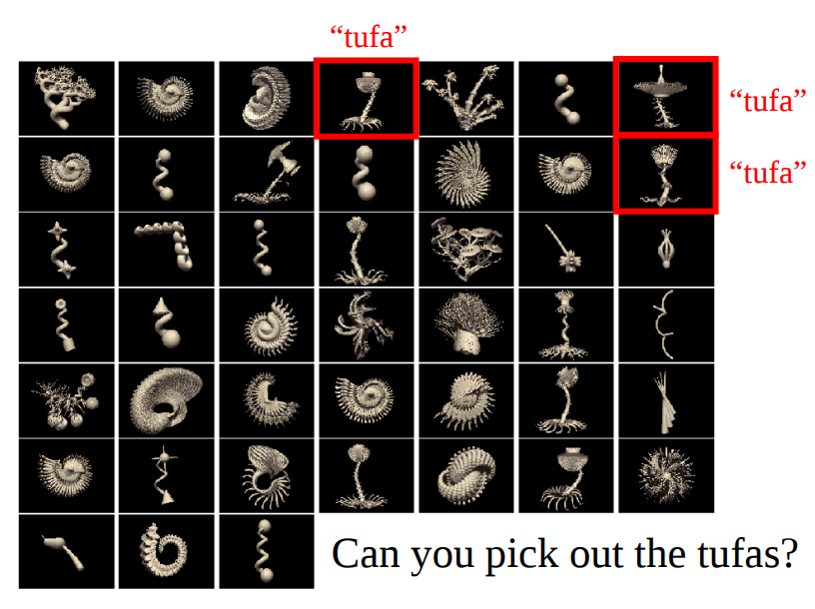
3/10
Notes:
One way to look at what LEARNING is :
How one would understand what the Tufa is given these three examples?
Sub conciously we are extracting features that describes what a Tufa is. Here, learning is about extracting features that allows us to classify things into groups.
Features such as a Tufa has a :
1. Circular mass/bulk on the top.
2. It has a stem.
3. Roots / tentacles at the bottom.

Slide 4
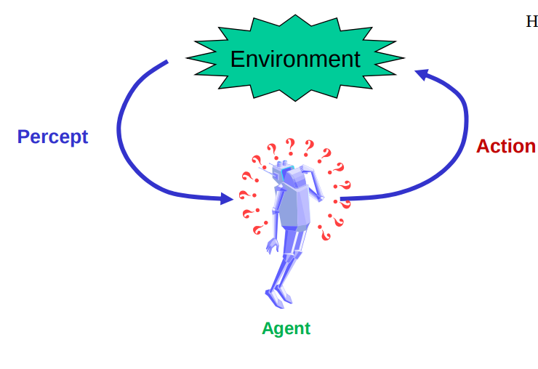
Another way of looking at Learning
Agent :
Interacts with the environment (action)
Has goals ( want to become better at some task T )
Receives feedback ( percept or a quantitative performance measure P)
Learning is about using each interaction with the environment as an opportunity to do better next time you encounter a similar task.
4/10
Notes:
We’ll discuss about variety of Goals or Tasks that Machine Learning can be used to achieve in the coming slides.
Kind of a Reinforcement Learning view. To be discussed in next weeek.

Slide 5
Tasks performed using Machine Learning
extracting features to solve predictive tasks
Forecasting :
Ex : Predicting room temperature to be set by AC depending on number of people in the room.
Filling missing data :
Ex : Numerous movies/shows on Amazon Prime are not rated yet. Rating them based on ratings given to other similar movies /shows.
Detecting anomalies :
Ex : Anomaly based Intrusion Detection System
5/10
Notes:
Example of Forecasting : Empirical analysis on Speed Dating ( https://github.com/PollenJain/Empirical-Analysis-on-Dating-Pattern/blob/master/Empirical_Analysis_On_Dating_Patterns.pdf )
Suggest them to take Data Analytics as elective if interested in Machine Learning.
Example of Detecting Anomalies : Suggest them how we see Intrusion Detection Systems in Information Security.

Slide 6
Tasks performed using Machine Learning
extracting features to solve predictive tasks
Classifying :
Ex : same as what we did with “TUFA” on slide 3
Another example : spam/ham
Summarizing :
Ex : Sentiment Analysis based on Tweets
Ranking :
Ex : Content Based Image Search Engine
6/10
Notes:
Example of Summarizing : Talk about Know Your Politician Project ( https://github.com/PollenJain/Know-your-Politician )
Example of Ranking: Ranking politicians using Summarizing based on Sentiment Analysis done in Know Your Politician Project and more.

Slide 7
When to apply Machine Learning?
Few of the many places where Machine Learning can be applied to :
Humans are unable to explain their expertise ( e.g., Speech Recognition, Vision, Language ).
Solution needs to be adapted to particular cases ( e.g., Biometrics : Finger Print Recognition on Phone ).
Problem size is too vast for our limited reasoning capabilities.
7/10
Notes:
Suggest that they can take Digital Image Processing as Elective. Finger Print Recognition as Project ( https://app.box.com/s/xp361t7rkxxcerxqse22s9bv27ohud49 )
Problem size is too vast for our limited reasoning capabilities. Talk about Classification of Cardiac Arrhythmia Project ( https://drive.google.com/open?id=0B9WUXb8hT24nOHZzbzVKNmRwSTQ )

Slide 8
Assignment
Watch the video by Nando de freitas on Introduction to Machine Learning :
https://www.youtube.com/watch?v=w2OtwL5T1ow&list=PLE6Wd9FR--EdyJ5lbFl8UuGjecvVw66F6
Slide deck used in that video :
https://github.com/PollenJain/PESU_I_O/blob/master/Machine_Learning_Hands_On_Using_Python/Week1/Resources/l1_nando_de_freitas.pdf
8/10

Slide 9
Feel free to explore the internet for the given tasks.
Any doubts?
Drop a mail on paragjainpes@gmail.com
Or
Put up your question on StackOverflow and then drop a mail with the link.
9/10

Slide 10
Thank You.
10/10

